Slide 1

01.02.2020
Welcome Everyone!!

Slide 2
Introduction to Shell Scripting

Slide 3
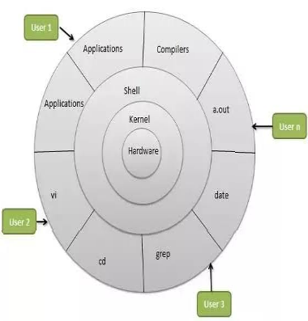
What is a Shell?
An Operating is made of many components,
but its two prime components are -
1.)Kernel
2.)Shell

Slide 4
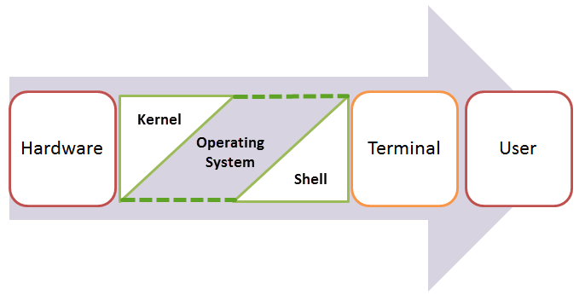
So what is kernel?
Kernel :- The Nucleus of an Computer.
Innermost part of the OS.
Makes the Communication between the hardware and software possible.
The Shell is the Outermost part.

Slide 5
Shell
Shell Scripting
Basic Workflow
It is a Command–Line Interpreter.
It forms the interface between the Kernel and the User.
Shell scripting is writing a series of command for the shell to execute.
It can combine lengthy and repetitive sequences of commands into a single and simple script.
User created Shell Script
Interpreted by the Shell
Get’s Converted to Binary
Now the Linux Kernel understands and starts processing your request,

Slide 6
Why should you use it?
You can use shell scripts to automate administrative tasks.
Encapsulate complex configuration details.
Get at the full power of the operating system.
The ability to combine commands allows you to create new commands.

Slide 7

Kinds of shells
Bourne Shell > prompt: $
Its derivatives -
Bash Shell (BASH)
Friendly interactive shell (FISH)
C Shell > prompt: %
Its derivatives -
Z Shell (ZSH)

Slide 8
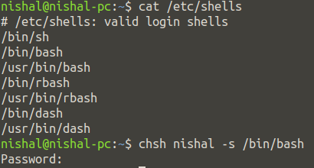
Changing Your Default Shell
To find all available shells in your system type following command:
~$ cat /etc/shells
The basic Syntax to change your shell :
~$ chsh username -s new_default_shell

Slide 9
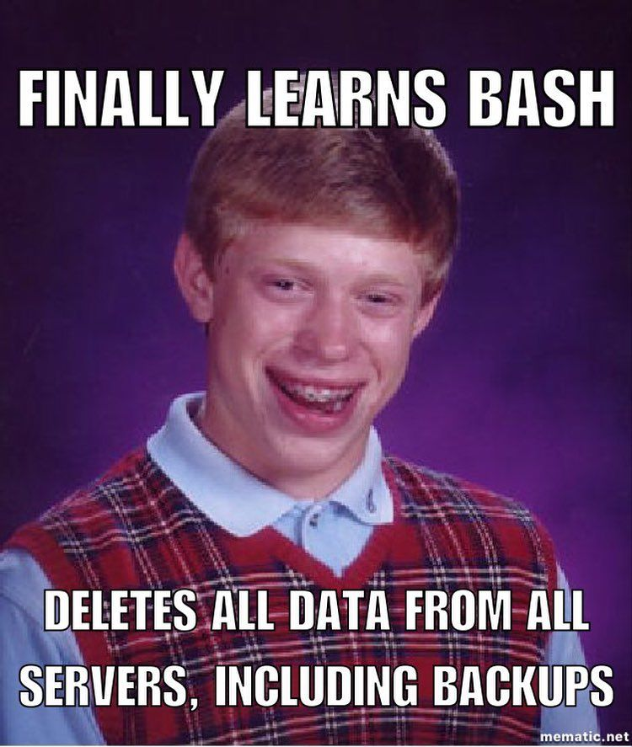
Time to code!

Slide 10
Shell code
C code
Hello World!
#include <stdio.h>
int main() {
printf("Hello, World!");
return 0;
}
#!/bin/bash
echo "Hello World"

Slide 11

Executing your shell script
Save your file as hello-world.sh
~$ chmod a+x hello-world.sh
You can run this using any one of the below two commands.
~$ bash hello-world.sh
~$ ./hello-world.sh

Slide 12
Shell code
C code
Comments?
#include <stdio.h>
int main() {
// Single Line Comment
/*
Multi-Line
Comment
*/
}
#!/bin/bash
# Single Line Comment
: '
This is a Multi Line
comment
'

Slide 13

Shell code
C code
Reading Input
#include <stdio.h>
int main() {
int something;
scanf(“%d”,&something);
printf(“%d”,something);
return 0;
}
#!/bin/bash
echo -n "Enter Something:"
read something
echo "You Entered: $something"

Slide 14

Shell code
C code
While Loops
#!/bin/bash
i=0
while [ $i -le 2 ]
do
echo Number: $i
((i++))
done
#include <stdio.h>
int main() {
int i=0;
while(i<=2){
printf(“Number: %d”,i);
i++;
}
}

Slide 15

Shell code
C code
For Loops
#!/bin/bash
for((counter=1; counter<=10; counter++ ))
do
echo -n "$counter "
done
#include <stdio.h>
int main() {
int counter;
for(counter=1;counter<=10;counter++){
printf(“%d ”,counter);
}
return 0;
}

Slide 16

Shell code
C code
Conditionals - if’s
#!/bin/bash
echo -n "Enter a number: "
read num
if [[ $num -gt 10 ]]
then
echo "Number is greater than 10."
elif [[ $num -eq 10 ]]
then
echo "Number is equal to 10."
else
echo "Number is less than 10."
fi
int num;
scanf(“%d”,&num);
if(num>10){
printf(“Number is greater than 10.”);
}else if(num==10){
printf(“Number is equal to 10.”);
}else{
printf(“Number is less than 10.”);
}

Slide 17

Shell code
C code
Switch
#!/bin/bash
read INPUT_STRING
case $INPUT_STRING in
hello)
echo "Hello yourself!"
;;
bye)
echo "See you again!"
;;
*)
echo "Sorry, I don't understand"
;;
esac
int num;
scanf(“%d”,&num);
switch(num){
case 0:
printf(“Hello yourself!”);
break;
case 1:
printf(“See you again!”);
break;
}
default:
printf(“Sorry, I don't understand”);
break;
}

Slide 18

Shell code
Output
Command Line arguments
#!/bin/bash
echo "Total arguments : $#"
echo "First Argument = $1"
echo "Second Argument = $2"

Slide 19

Shell code
Output
String operations
#!/bin/bash
# Concatenation
string1="VIT"
string2="LUG"
ccstring=$string1$string2
echo "$ccstring is the best club in $string1!"
# Slicing
str="VITLUG is the best club in VIT!"
subStr=${str:0:23}
echo $subStr

Slide 20

Shell code
Output
Functions
#!/bin/bash
function Greet() {
str="Hello $name, hope you are learning new stuff!"
echo $str
}
echo "-> what's your name?"
read name
val=$(Greet)
echo -e "-> $val"

Slide 21
We are done with the “basic stuff”...

Slide 22


Shell code
Output
Creating Directories from Bash Scripts
#!/bin/bash
echo -n "Enter directory name ->"
read dir
if [ -d "$dir" ]
then
echo "Directory exists"
else
`mkdir $dir`
echo "Directory created"
fi

Slide 23
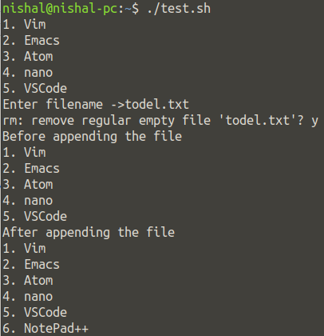
Shell code
Output
File Operations
#!/bin/bash
# Reading a file
file='editors.txt'
while read line; do
echo $line
done < $file
# Deleting a file
echo -n "Enter filename ->"
read name
rm -i $name
# Appending to a file
echo "Before appending the file"
cat editors.txt
echo "6. NotePad++" >> editors.txt
echo "After appending the file"
cat editors.txt

Slide 24


Shell code
Output
Sleep & Wait
The sleep command allows your shell script to pause between instructions.
#!/bin/bash
echo "How long to wait?"
read time
sleep $time
echo "Waited for $time seconds!"
The wait command is used for pausing system processes from Linux bash scripts.
#!/bin/bash
echo "Testing wait command"
sleep 5 &
pid=$!
kill $pid
wait $pid
echo $pid was terminated.

Slide 25

Simple
Applications

Slide 26
Send Mails from Shell Scripts
#!/bin/bash
recipient=”admin@example.com”
subject=”Greetings”
message=”Welcome to VITLUG SESSION 1”
`mail -s $subject $recipient <<< $message`

Slide 27
Adding Batch Extensions
#!/bin/bash
dir=$1
for file in `ls $1/*`
do
mv $file $file.txt
done

Slide 28

Removing Duplicate Lines from Files
#! /bin/sh
echo -n "Enter Filename-> "
read filename
if [ -f "$filename" ]; then
sort $filename | uniq | tee sorted.txt
else
echo "No $filename in $pwd...try again"
fi
exit 0
Tip - grep is another very important command which is used to search for a particular text within the file and generate the output for you related to the pattern being matched.

Slide 29
System Maintenance
#!/bin/bash
echo -e "\n$(date "+%d-%m-%Y --- %T") --- Starting work\n"
apt-get update
apt-get -y upgrade
apt-get -y autoremove
apt-get autoclean
echo -e "\n$(date "+%T") \t Script Terminated"

Slide 30
Thank You
Thank You

